Slide 1
Internal Notes
This slide deck is the same content as the project documentation (README, etc.) but in presentation form.

Slide 2
Guidance for Instance Expiration on AWS
Amazon Web Services
An Introduction

Slide 3
Purpose
The Guidance for Instance Expiration on AWS stops (or terminates) EC2 instances that have run (or existed) past the expiration values defined in their tags.
Example use cases:
Preset temporary EC2 instances to automatically terminate after a specified duration.
Auto-stop an occasionally-used operations EC2 instance every time it is running for more than 1 day.
Prevent ephemeral EC2 instances (ex: build agent machines) from existing beyond their expected use.

Slide 4
Features
Relative and Absolute Tags - Tag values can be relative to an EC2 instance's launch time (easier in some cases because an automation does not need to calculate a future date) or an absolute date/time value.
Event Driven - Monitors EC2 instance tags and schedules required stop/terminate actions using the Amazon EventBridge Scheduler. This provides better precision (actions are very close to their schedule times) and is more efficient than polling.
Custom Tag Prefix - The default `expiration:` tag prefix can be replaced with a custom value.
Events - Events for expiration actions are emitted to an Amazon EventBridge Event Bus for optional integration/automation.
Notifications - If an SNS Topic is specified it will receive events for expiration actions, for example enabling administrators to subscribe for notifications.
CloudWatch Dashboard - An optional CloudWatch Dashboard provides metrics, insights, and logs for the guidance.

Slide 5
Deployment
The guidance is provided is an app based on the AWS Cloud Development Kit (CDK), which is a free infrastructure-as-code platform.
One runs the app to generate an AWS CloudFormation template that is then deployed to an AWS account.
This results in a set of resources (Amazon EventBridge Scheduler, AWS Lambda, etc.) that implements the solution.
* Experience with the AWS CDK is not required

Slide 6
Deployment Parameters
Several CloudFormation parameters can be supplied during deployment:
Name | Values | Purpose
TagPrefix | String | Prefix for the EC2 instance tags inspected.
StopAction | Enable | Disable | Enable or disable stopping EC2 instances.
TerminateAction | Enable | Disable | Enable or disable terminating EC2 instances.
BackupCheckPeriod | Integer (minutes) | Period for backup check invocations, in minutes.
EventBusName | String | Name of existing EventBridge bus for action events.
SnsTopicName | String | Name of existing SNS Topic for action event notifications.
CloudWatch | Enable | Disable | Enable or disable CloudWatch dashboard.

Slide 7
Usage
Once deployed, one need only set expiration tags as desired.
Tag Name | Behavior
expiration:stop-after-duration | Stop the instance after a duration since its launch date/time.
expiration:stop-after-datetime | Stop the instance at an absolute date/time.
expiration:terminate-after-duration | Terminate the instance after a duration since its launch date/time.
expiration:terminate-after-datetime | Terminate the instance at an absolute date/time.

Slide 8
Note:
The EC2 service defines an EC2 instance's "launch date/time" from the last time it was started - not from when it was created or started for the first time. (This behavior is not specific to this guidance.)
A misunderstanding of this EC2 instance attribute can lead to unexpected behavior.
For example, every time an instance with the expiration:stop-after-duration tag is started it becomes eligible once again to be stopped by the guidance.

Slide 9
Expiration Tag Formats
Duration Tag
[#d][#h][#m][#s]
The days, hours, minutes, and seconds fields are each optional and each prefixed with an integer.
Examples:
Date/Time Tag
YYYY-MM-DD HH:MM:SS UTC
All fields (year, month, day, hours, minutes, seconds) are required and must be zero-padded to the length specified by the format above. The `UTC` timezone designation is required (other timezones are not supported).
1d2h3m4s
10d14h
24h
10d

Slide 10
Events
If the EventBusName CloudFormation template parameter value set during deployment refers to a valid Event Bus then the guidance will emit events for actions taken (stopping or terminating EC2 instances).
Also, an Event Bus Rule will be created for these events.
One may add targets to the rule, or use it as a reference for creating other rules.

Slide 11
Notifications
If the SnSTopicName CloudFormation template parameter value set during deployment refers to a valid SNS Topic then it will be added as a target to the Event Bus Rule, and any subscriptions to the SNS Topic will receive notifications about expiration actions.
For example, an administrator may subscribe their email address to the SNS Topic.

Slide 12
Scope
The guidance only acts within the AWS account and region in which it is deployed.
No provisions are provided for use across multiple accounts or regions.
One can deploy the guidance independently in multiple accounts and/or regions.

Slide 13
Risk
With this guidance deployed and enabled it becomes possible to stop or terminate an EC2 instance via editing its expiration tags.
i.e., anybody (or anything) that can create or modify an expiration tag could abuse that permission to effectively stop or terminate the instance.
This is not a concern entirely unique to this guidance. Tags are commonly, but not universally, used in access control and automations. However, it is notable enough to warrant consideration.
See the project USAGE documentation for more details and the Managed IAM Policy created by this solution that can be used to deny expiration tag creation and editing as a risk mitigation.

Slide 14
Costs
Typical deployment of this guidance is estimated to cost less than $1 USD / month to operate under even heavy usage, and less than $10 USD / month under even the most extreme usage.
One may choose to enable the optional CloudWatch Dashboard, which adds approximately $12 USD / month.
A cost estimation spreadsheet is provided with details, important assumptions, and calculations. Custom inputs can also be set in the spreadsheet for custom estimates.
See the project COSTS documentation for full information.

Slide 15
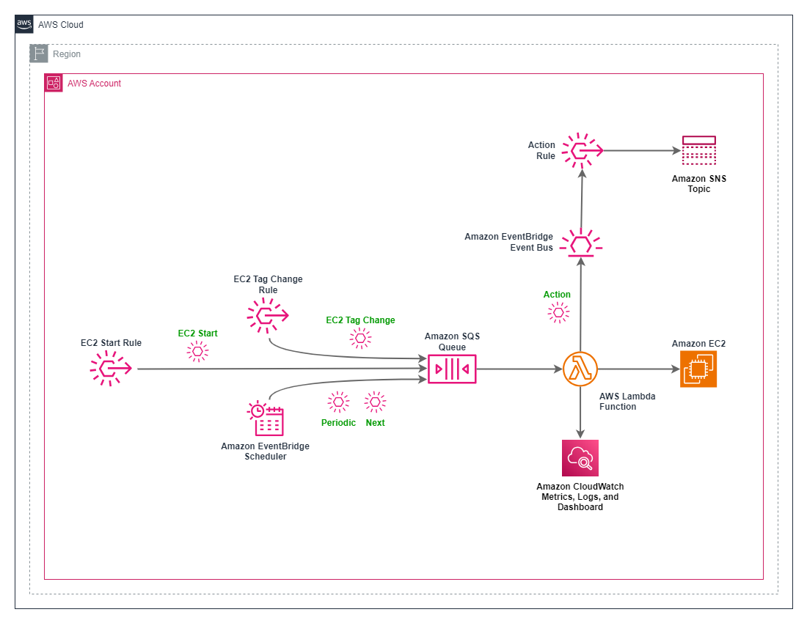
Design

Slide 16
Miscellaneous
Availability
This guidance is available from the AWS Solutions Library.
Support
See the project site’s issues list to report a bug, request a feature, provide feedback, or request assistance.
License
The guidance is provided under the Apache 2.0 License.

Slide 17
Resources
Project Site
https://gitlab.aws.dev/ryamelvi/ec2-instance-watchdog

